Slide 1
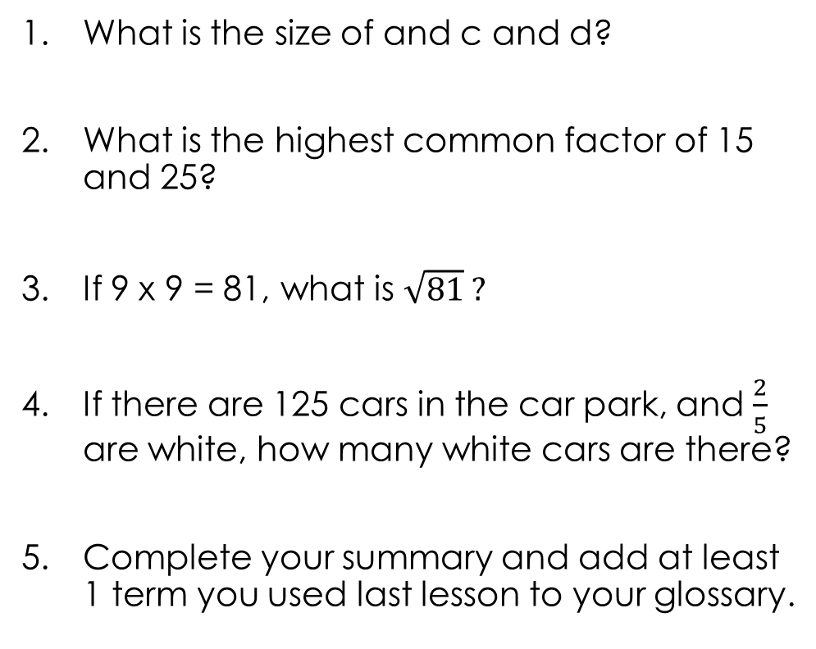
5 Questions
What is the size of and c and d?
What is the highest common factor of 15 and 25?
If 9 x 9 = 81, what is $\sqrt{81} ?$
If there are 125 cars in the car park, and $\frac{2}{5}$ are white, how many white cars are there?
Complete your summary and add at least 1 term you used last lesson to your glossary.
d
c
145º

Slide 2
Learning Intentions
Students will be able to
Identify corresponding angles
Solve problems with corresponding angles

Slide 3
24
7
30
Topic: Angles in parallel lines
Date:
EQ – What are corresponding and alternate angles?
What are parallel lines?
Two lines that never meet or cross
What is a transversal line?
A line that cuts through other lines
What is corresponding?
Corresponding means matching

Slide 4
24
7
30
Topic: Angles in parallel lines
Date:
EQ – What are corresponding and alternate angles?
What are corresponding angles?
When a transversal line cuts through two parallel lines, four pairs of corresponding (matching) angles are formed.
The corresponding angles are equal in size
Individual: Draw two parallel lines on your page and a transversal line. Measure all the angles!

Slide 5


Slide 6
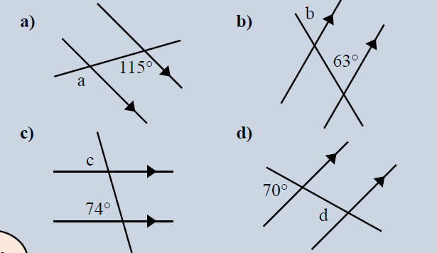
Guided Practice
Draw these on your left hand side!
Notes:
Draw 3-4 angles on the board going through each step.

Slide 7
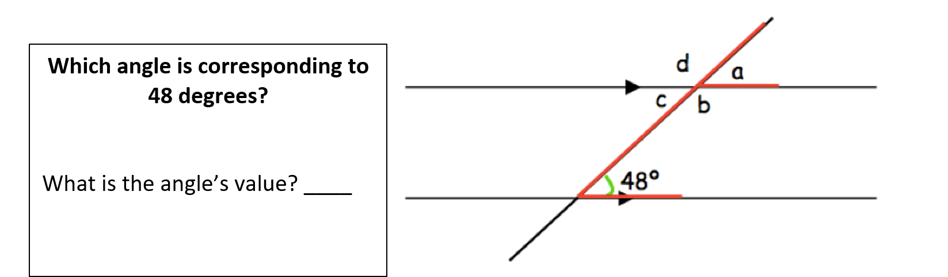
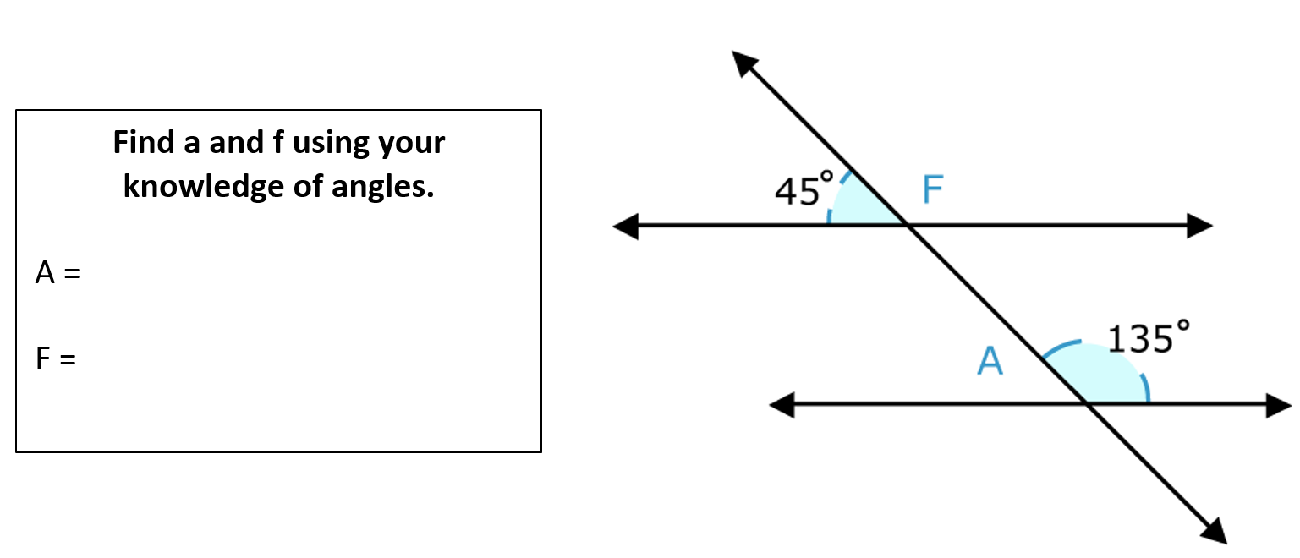
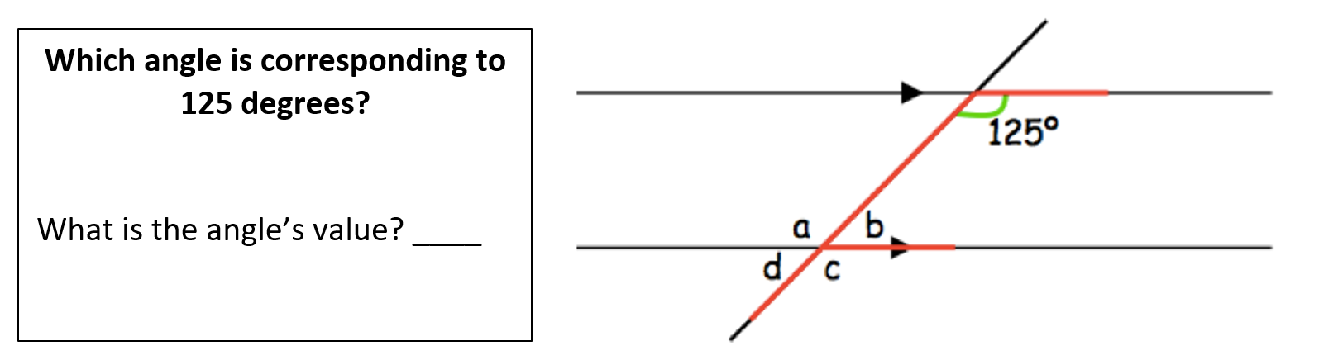
You can work together to solve the following questions.

Slide 8
24
7
30
Topic: Angles in parallel lines
Date
EQ – What are corresponding and alternate angles?
What are Alternate angles?
When a line cuts through two parallel lines, Alternate angles are formed by a Z shape.
Alternate angles are equal.
5
Notes:
Lesson objective (EQ)

Slide 9
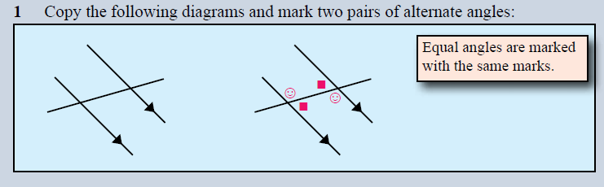
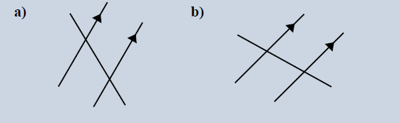
Copy and mark the pairs of Alternate angles
Notes:
Check for understanding

Slide 10
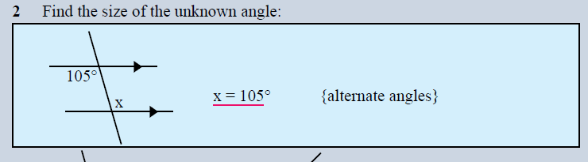
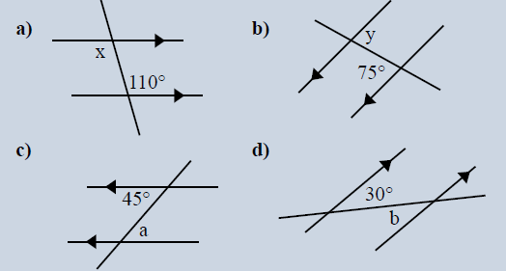
Find the size of the unknown angles
Notes:
Guided practice

